Slide 1

TCX3212 Phase 2 Report
Rental Market
Predictive
A Predictive Analytics Study of Rental & Vacancy Dynamics
in Singapore’s Rental Sector
April 2026
Low Ruenn Rong Rayna (A0311396E) Noviana Ghovin (A0265428X)
5,027
48 mo
R²=0.813
AUC=0.812
Listings Analyzed
Study Period
Best Regression
Best Classification

Slide 2
01
Project Context & Objectives
Research Question
Rental Price Prediction
As flexible rental options expand rapidly in Singapore, can predictive analytics deliver actionable insights for understanding vacancy and rental dynamics?
R² > 0.70
Target Performance
Metrics: RMSE, MAE, R²
Why Rental Sector?
High property prices driving demand for affordable alternatives
Young professionals, expats & students key tenant segments
Vacancy Prediction
Rents shaped by economic cycles and government policy
No quantitative predictive models exist in literature
AUC > 0.70
Target Performance
Metrics: AUC, Accuracy
Both Success Criteria Met
Random Forest R² = 0.813 | Logistic Regression AUC = 0.812 | Held-out 2024 test set validation

Slide 3
02
Domain & Data
Pivoted to web scraping + open government data; neighbourhood demand operationalised, policy dummies anchored to exact circular dates.
99.co / PropertyGuru
LTA DataMall API
URA / SingStat / MND
Web scraping (HTML parsing)
MRT station coordinates (free)
Rental transactions (demand proxy)
Composite key deduplication
Haversine → mrt_dist_km
Population density by area
Fuzzy address matching
Open API, no auth required
Policy circular dates (manual)
Policy-Period Dummies — Exact Date Windows
d_covid_phase2
d_absd_hike_2021
d_rental_surge
d_ahd_tightening
d_ura_guidelines
COVID Phase 2 HA
ABSD Increase
Post-COVID Rental Surge
URA AHD Tightening
URA Co-living Framework
2021-05-16 → 2021-08-09
2021-12-16 → 2022-06-30
2022-01-01 → 2022-12-31
2022-09-01 → 2023-03-31
2023-01-01 → 2023-12-31
↓ Demand, ↓ Price
↑ Co-living demand
↑ Price +SGD 371
↓ Supply, ↑ Price
Compliance → ↑ Price

Slide 4
03
Methodological Framework
1
Business Understanding
2
Data Understanding
3
Data Preparation
Define objectives and success criteria
EDA, quality checks, insights
Clean, encode, scale, split
4
Modelling
5
Evaluation
4 regression + 4 classification
5-fold CV + temporal test
1
Iteration 1 — Data Pivot
2
Iteration 2 — Model Upgrade
Operator records proved inaccessible → full redesign between Business Understanding and Data Understanding phases.
Initial linear models degraded on the held-out 2024 test despite strong CV scores → ensemble methods added.
Pivoted to 99.co scraping + open government APIs (LTA, URA, SingStat)
Random Forest, Gradient Boosting to capture non-linear temporal dynamics

Slide 5
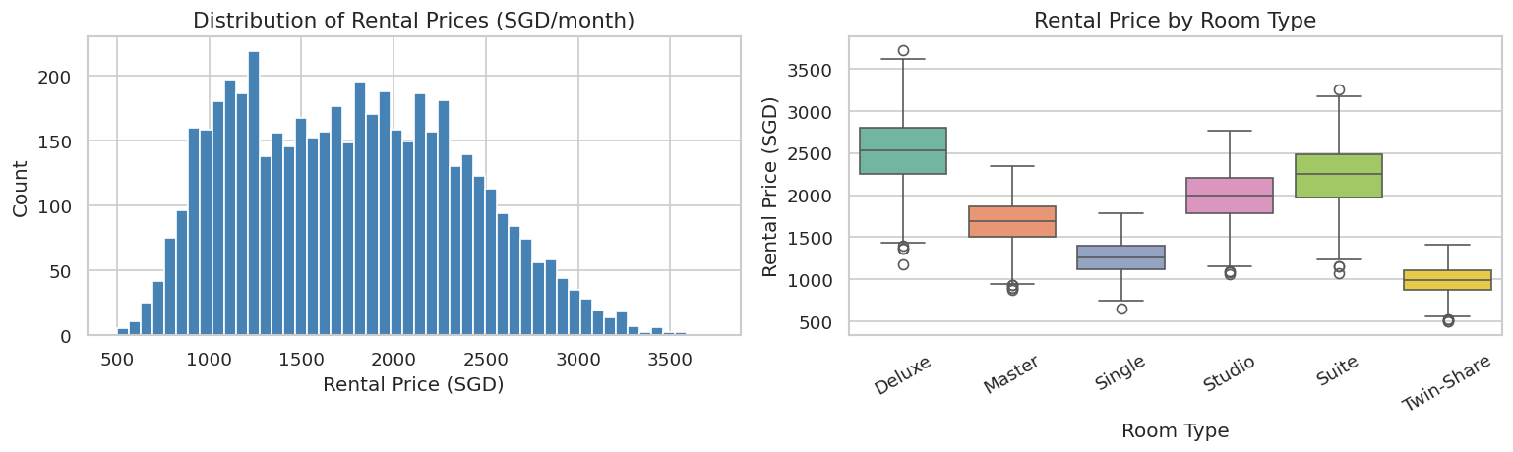

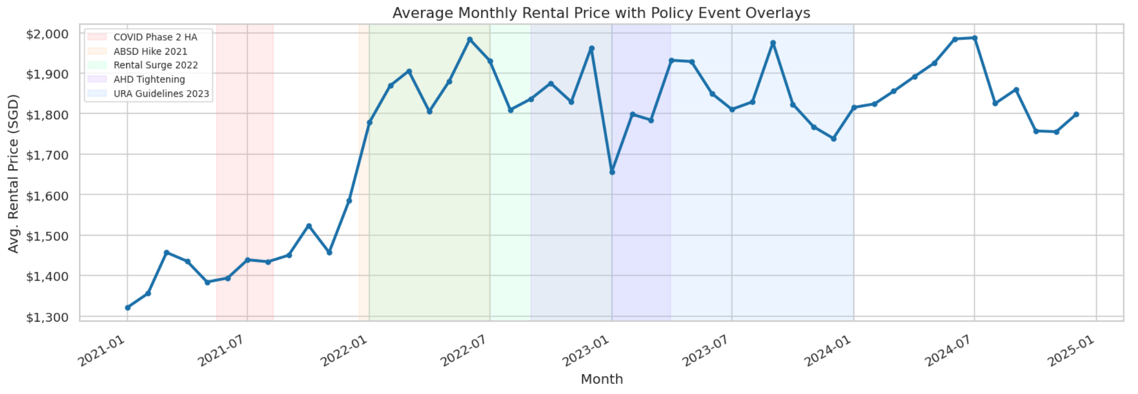
04
Data Exploration — Visual Insights
Distribution of Rental Prices
SGD 1,769 per month
SGD 608 standard deviation
0.25 right skew
Rental Price by Room Type
SGD 700-900 | Twin Share lowest-tier
SGD 1,600-2,000 | Deluxe & Suites highest tier
Rental Price with Policy Event Overlays
2022 | Dominant rental surge
SGD 200-400 | above 2022 baseline
Visual Insight Summary
The visualizations confirm room type as primary driver of price variance. These distinct shifts validate all five policy dummies as essential binary features, encoding regime information that continuous time variables cannot capture.

Slide 6
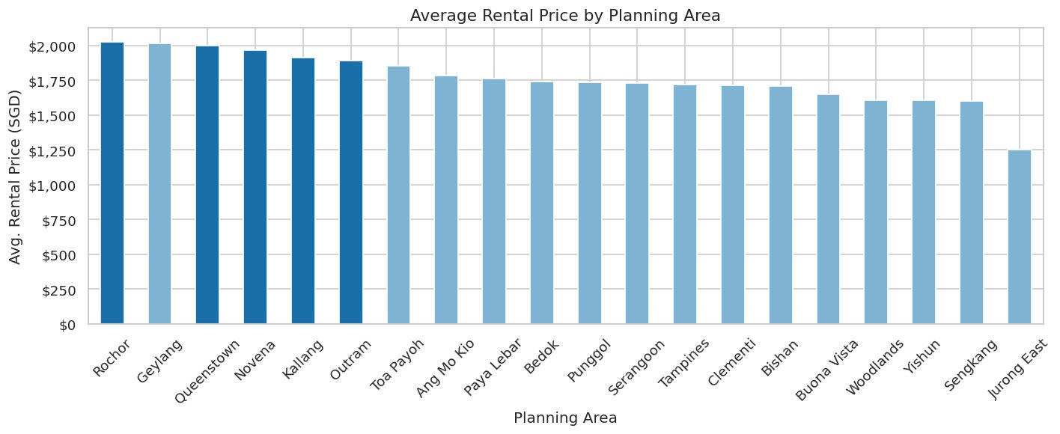
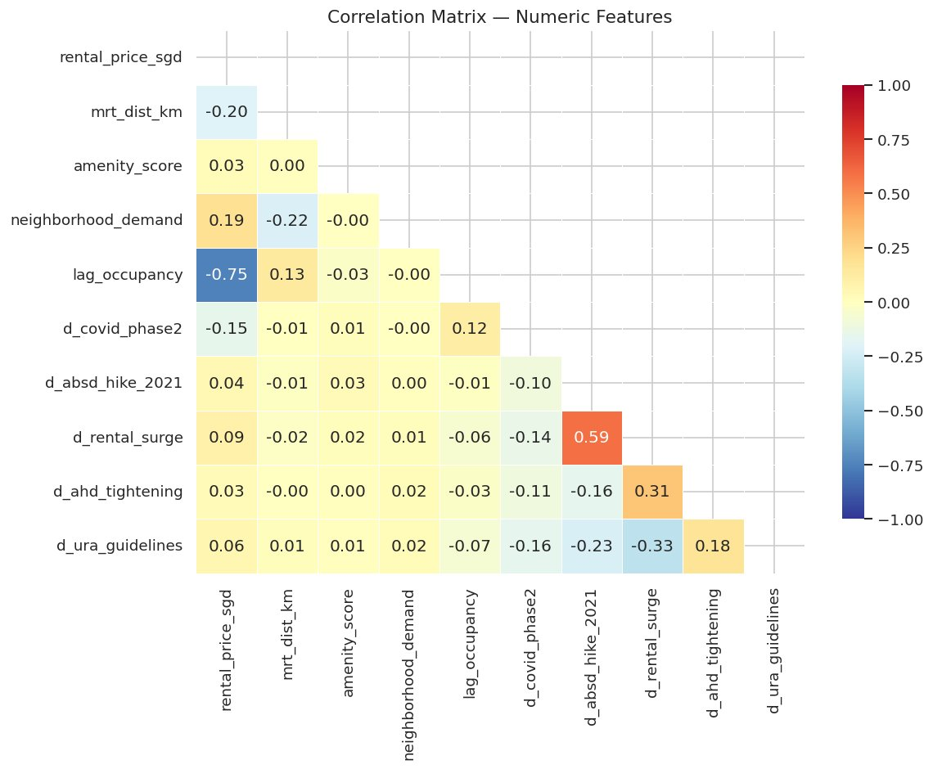
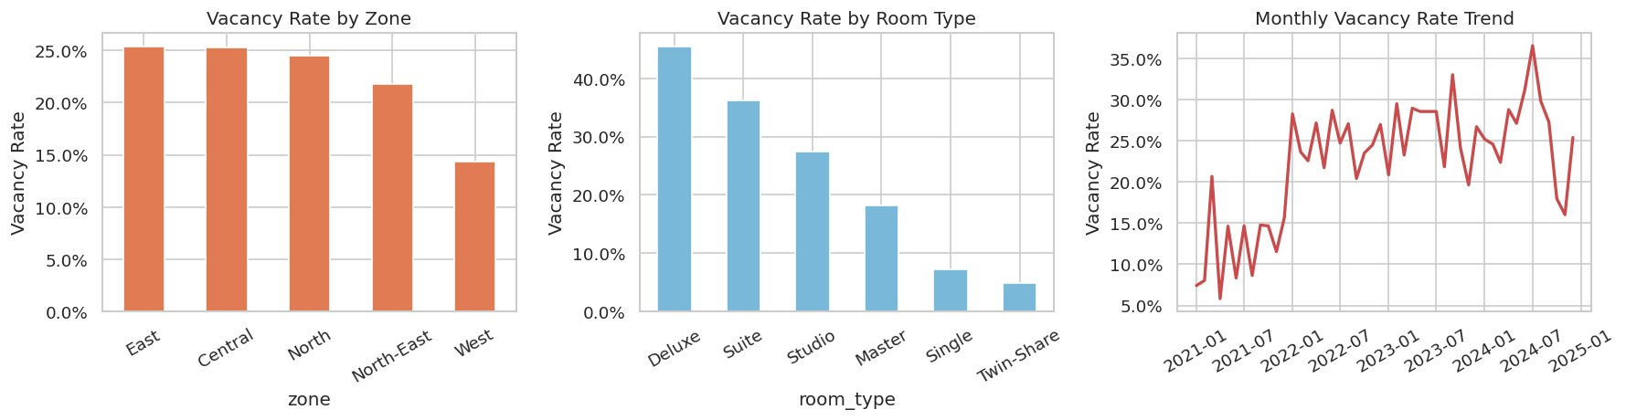
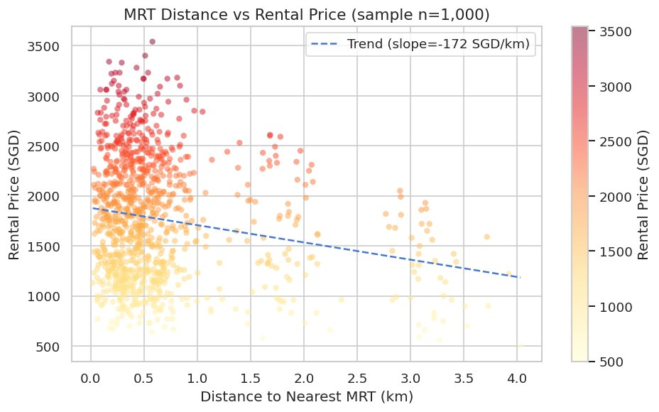
04
Data Exploration — Visual Insights
Pearson Correlation Matrix
Feature interrelationships
Distribution across Singapore regions
Rental by Planning Area
Central zone SGD 300–500 above North/West
Surge dummy strongest correlation (r ≈ 0.35)
MRT Distance vs Rental Price
Proximity premium analysis
North vacancy ~28% | Central ~19%
Vacancy by Zone, Room Type & Trend
~SGD 80 discount per km from MRT
Monthly vacancy patterns
Visual Insight Summary
The visualizations confirm geographic stratification and policy impact as primary drivers, with MRT proximity providing a continuous spatial gradient for modeling.

Slide 7
04
Data Exploration
SGD 1,769
SGD 608
23.1%
0.25
Mean Rental/mo
Std Dev
Vacancy Rate
Price Skewness
EDA → Modelling Decisions
23.1% vacancy → class imbalance
→ AUC used over accuracy; F1 per class reported
Slight right skew (0.25)
→ Log-transform not needed; tree models handle natively
Policy dummies shift price visibly
→ All five dummies validated as binary features
Central zone premium SGD 300–500
→ Zone encoded as OHE categorical feature
MRT: ~SGD 80 discount per km
Key Insight
→ mrt_dist_km included as key continuous predictor
The EDA revealed that location factors (zone, MRT proximity) and temporal policy effects are the strongest predictors, guiding our feature engineering strategy.

Slide 8
05
Data Preparation Pipeline
Clean
Engineer
Encode
1
No missing values • Dedup: composite key • Fuzzy address match
2
mrt_dist_km • neighborhood_demand • lag_occupancy
3
5 policy dummies • OHE: room_type, zone, lease_type
4
Scale
5
Split
MinMaxScaler all numeric → [0,1]
Temporal: Train 2021–23 • Test 2024 (holdout)
Feature Taxonomy
Temporal Split Strategy
mrt_dist_km
Numeric
Haversine distance to nearest MRT
Train Set
69.5%
neighborhood_demand
Numeric
URA transactions per area/month (0–100)
2021–2023 | n = 3,493
lag_occupancy
Numeric
Prior-month occupancy (autoregressive)
Test Set
30.5%
2024 only | n = 1,534
amenity_score
Numeric
n_amenities / 7
5 policy dummies
Binary
Coded from MND/URA circular dates
Temporal Split — Not Random
room_type, zone, lease_type
OHE
One-hot encoded, drop='first'
Avoids data leakage from future into training, ensuring realistic model evaluation.

Slide 9
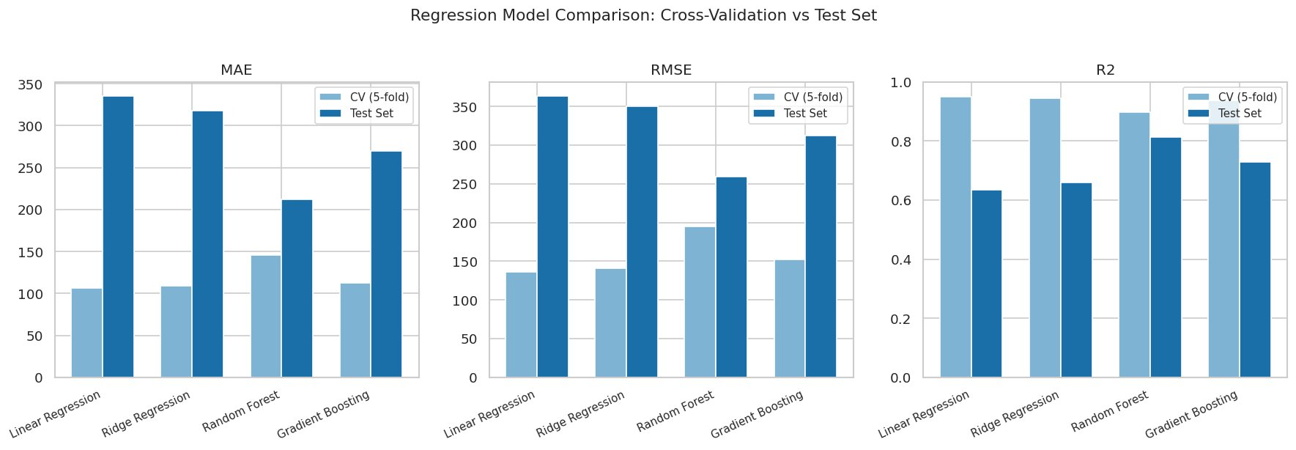
06
Rental Price Prediction
5-Fold CV + Held-Out 2024 Test Set
Model Performance Comparison
Model
CV RMSE
Test RMSE
Test R²
Test MAE
Linear Regression
136.0
363.4
0.634
335.3
Ridge (α=10)
141.4
350.0
0.660
317.7
Top Feature Importances
Zone
100%
Gradient Boosting
152.0
311.9
0.730
269.5
Demand
85%
Surge
78%
Random Forest
194.9
259.5
0.813
211.9
MRT Dist
65%
Room Type
52%
Selected Model: Random Forest — Best test R² (0.813) & lowest RMSE (SGD 259.5)
Why Random Forest?
Linear/Ridge degraded on 2024 test despite strong CV, they under capture non-linear year on year dynamics . Feature importance confirms zone, demand, surge & MRT distance as primary drivers.

Slide 10
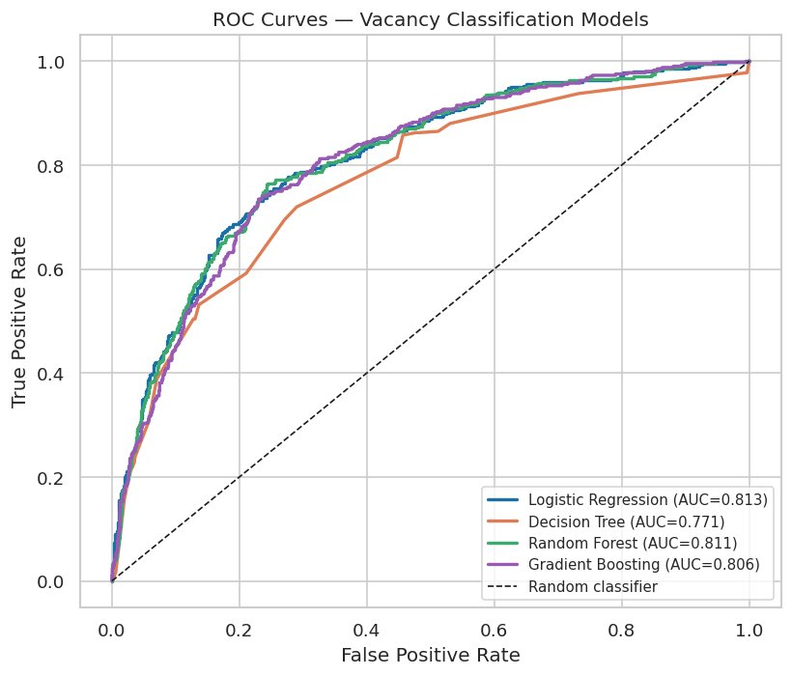
06
Vacancy Prediction
5-Fold CV + Held-Out 2024 Test Set
Model Performance Comparison
ROC Curve Analysis
Model
CV AUC
Test AUC
Accuracy
F1 (Vacant)
Logistic Reg.
0.806
0.812
0.785
0.41
ROC Curves — All 4 Models
Decision Tree
0.650
0.771
0.777
0.36
AUC comparison visualization
Random Forest
0.804
0.811
0.767
0.39
Gradient Boosting
0.798
0.806
0.779
0.38
Logistic: 0.812
Random Forest: 0.811
Selected Model: Logistic Regression — Highest test AUC (0.812) with maximum interpretability
Why Logistic Regression?
Vacancy is approximately linearly separable — AUC gap vs Random Forest negligible (0.001). Offers maximum interpretability: operators read coefficients as vacancy risk drivers directly.

Slide 11
06
Model Evaluation — Final Results
Best Regression
Best Classifier
Random Forest
Logistic Regression
0.813
259.5
211.9
0.812
78.5%
0.41
R²
RMSE
MAE
AUC
Accuracy
F1 (vacant)
Policy Impact on Rental Price
Sample Predictions
COVID Phase 2 HA
−SGD 75
Central Suite
SGD 1,968
2021-05-16 → 2021-08-09
Premium location, full amenities
ABSD Hike 2021
+SGD 3
East Single
SGD 1,205
2021-12-16 → 2022-06-30
Standard room, good MRT access
Rental Surge 2022
+SGD 371
North Twin-Share (surge)
SGD 958
2022-01-01 → 2022-12-31
Shared room, during rental surge
URA Guidelines 2023
+SGD 255
2023-01-01 → 2023-12-31
Success Criteria Met
Baseline: SGD 1,723
✅ R² > 0.70 | ✅ AUC > 0.70

Slide 12
07
Discussion & Conclusion
Success Criteria Met
Limitations
Synthetic data — needs live 99.co scraping
R² = 0.813
AUC = 0.812
Monthly granularity — weekly modelling recommended
Target: > 0.70 ✓
Target: > 0.70 ✓
No spatial autocorrelation correction (GWR)
Both criteria met on held-out 2024 test set
Vacant F1 = 0.41 — SMOTE/class-weighting needed
Key Drivers Identified
Recommendations for Future Work
Live scraping pipeline (99.co / PropertyGuru)
1
Geographic zone
Weekly-frequency vacancy modelling
Central premium SGD 300–500
GWR for spatial heterogeneity (Chen et al., 2024)
2
MRT proximity
SHAP for operator pricing dashboards
~SGD 80/km discount
LSTM / Prophet for forward forecasting
3
Neighbourhood demand
URA transaction index
4
Policy regime
Rental surge 2022: +SGD 371
Predictive analytics transforms rental housing management from reactive to data-driven — enabling pricing optimisation for operators, vacancy risk management for investors, and policy impact simulation for regulators.

Slide 13

References
Chen, L. J., Chuen, G. S., & Thow, Y. K. (n.d.). Predicting HDB rental price in Singapore. National University of Singapore.
Land Transport Authority (LTA). (2023). DataMall API — train station codes and Chinese names.
Ong, S. S. (2022). A new player in the market: Co-living entrants impacting the rental ecosystem [Master's thesis, NUS].
Urban Redevelopment Authority. (2022, Oct). Guidelines on dwelling units in non-landed residential developments (dc22-10).
Chen, W., Farag, S., Butt, U., & Al-Khateeb, H. (2024). Leveraging machine learning for sophisticated rental value predictions. Applied Sciences, 14(20), 9528.
Lim, J. S. (2021). Effect of co-living spaces on non-landed private residential property rents in Singapore [Master's thesis, NUS].
Salary.sg. (2025). The rise of co-living spaces in Singapore.
Urban Redevelopment Authority. (2023, Jan 27). Release of 4th Quarter 2022 real estate statistics.
Cribs. (2024, August 4). Co-living spaces in Singapore: Analysing their growth and impact on the rental market.
Ministry of Finance, MND, & MAS. (2021, December 15). Measures to cool the property market.
Singapore Business Review. (2024). Student demand fuels next phase of co-living.
Urban Redevelopment Authority. (2023, Dec 20). Temporary relaxation of occupancy cap.
Ministry of Health. (2021, May 14). Updates on local situation and heightened alert.
Urban Redevelopment Authority. (2024). Private residential property rental statistics.
CoLive Predictive
TCX3212 Phase 2
Low Ruenn Rong Rayna & Noviana Ghovin
April 2026

